Slide 1

Application Layer: Overview
P2P applications
Principles of network applications
Web and HTTP
E-mail, SMTP, IMAP
The Domain Name System DNS

Slide 2
















Peer-to-peer (P2P) architecture
no always-on server
arbitrary end systems directly communicate
peers request service from other peers, provide service in return to other peers
self scalability – new peers bring new service capacity, and new service demands
peers are intermittently connected and change IP addresses
complex management
examples: P2P file sharing (BitTorrent), streaming (KanKan), VoIP (Skype)
mobile network
national or global ISP
local or regional ISP
home network
content
provider
network
datacenter
network
enterprise
network

Slide 3

File distribution: client-server vs P2P
Q: how much time to distribute file (size F) from one server to N peers?
peer upload/download capacity is limited resource
u_{s}: server upload capacity
d_{i}: peer i download capacity
file, size F
u₁
d₁
u₂
u_{s}
d₂
server
d_{i}
u_{N}
network (with abundant
bandwidth)
u_{i}
d_{N}
u_{i}: peer i upload capacity

Slide 4
File distribution time: client-server
server transmission: must sequentially send (upload) N file copies:
time to send one copy: F/u_{s}
time to send N copies: NF/u_{s}
F
u_{s}
d_{i}
network
client: each client must download file copy
d_{min} = min client download rate
min client download time: F/d_{min}
u_{i}
time to distribute F
to N clients using
client-server approach
D_{c-s} > max{NF/u_{s,},F/d_{min}}
increases linearly in N

Slide 5
File distribution time: P2P
server transmission: must upload at least one copy:
time to send one copy: F/u_{s}
F
u_{s}
client: each client must download file copy
min client download time: F/d_{min}
d_{i}
network
u_{i}
clients: as aggregate must download NF bits
max upload rate (limiting max download rate) is u_{s} + Σu_{i}
time to distribute F
to N clients using
P2P approach
D_{P2P} > max{F/u_{s,},F/d_{min,},NF/(u_{s} + Σu_{i})}
increases linearly in N …
… but so does this, as each peer brings service capacity

Slide 6
Client-server vs. P2P: example
client upload rate = u, F/u = 1 hour, u_{s} = 10u, d_{min} ≥ u_{s}

Slide 7


P2P file distribution: BitTorrent
file divided into 256Kb chunks
peers in torrent send/receive file chunks
tracker: tracks peers
participating in torrent
torrent: group of peers exchanging chunks of a file
Alice arrives …
… obtains list
of peers from tracker
… and begins exchanging
file chunks with peers in torrent

Slide 8


P2P file distribution: BitTorrent
peer joining torrent:
has no chunks, but will accumulate them over time from other peers
registers with tracker to get list of peers, connects to subset of peers (“neighbors”)
while downloading, peer uploads chunks to other peers
peer may change peers with whom it exchanges chunks
churn: peers may come and go
once peer has entire file, it may (selfishly) leave or (altruistically) remain in torrent

Slide 9
BitTorrent: requesting, sending file chunks
Requesting chunks:
at any given time, different peers have different subsets of file chunks
periodically, Alice asks each peer for list of chunks that they have
Alice requests missing chunks from peers, rarest first
Sending chunks: tit-for-tat
Alice sends chunks to those four peers currently sending her chunks at highest rate
other peers are choked by Alice (do not receive chunks from her)
re-evaluate top 4 every10 secs
every 30 secs: randomly select another peer, starts sending chunks
“optimistically unchoke” this peer
newly chosen peer may join top 4

Slide 10

BitTorrent: tit-for-tat
(1) Alice “optimistically unchokes” Bob
(2) Alice becomes one of Bob’s top-four providers; Bob reciprocates
(3) Bob becomes one of Alice’s top-four providers
higher upload rate: find better trading partners, get file faster !

Slide 11
P2P Applications
File Sharing and Distribution
BitTorrent
Cryptocurrency Networks
Bitcoin
Ethereum
P2P Gaming
Decentralized Market Places
P2P VPN
P2P Cloud Storage
P2P Video Streaming

Slide 12
Application layer: overview
P2P applications
video streaming and content distribution networks
socket programming with UDP and TCP
Principles of network applications
Web and HTTP
E-mail, SMTP, IMAP
The Domain Name System DNS

Slide 13




Video Streaming and CDNs: context
stream video traffic: major consumer of Internet bandwidth
Netflix, YouTube, Amazon Prime: 80% of residential ISP traffic (2020)
challenge: scale - how to reach ~1B users?
challenge: heterogeneity
different users have different capabilities (e.g., wired versus mobile; bandwidth rich versus bandwidth poor)
solution: distributed, application-level infrastructure

Slide 14

Multimedia: video
spatial coding example: instead of sending N values of same color (all purple), send only two values: color value (purple) and number of repeated values (N)
video: sequence of images displayed at constant rate
e.g., 24 images/sec
digital image: array of pixels
each pixel represented by bits
coding: use redundancy within and between images to decrease # bits used to encode image
spatial (within image)
temporal (from one image to next)
……………………..
……………….…….
frame i
temporal coding example: instead of sending complete frame at i+1, send only differences from frame i
frame i+1

Slide 15
Multimedia: video
spatial coding example: instead of sending N values of same color (all purple), send only two values: color value (purple) and number of repeated values (N)
CBR: (constant bit rate): video encoding rate fixed
VBR: (variable bit rate): video encoding rate changes as amount of spatial, temporal coding changes
examples:
MPEG 1 (CD-ROM) 1.5 Mbps
MPEG2 (DVD) 3-6 Mbps
MPEG4 (often used in Internet, 64Kbps – 12 Mbps)
……………………..
……………….…….
frame i
temporal coding example: instead of sending complete frame at i+1, send only differences from frame i
frame i+1

Slide 16


Streaming stored video
simple scenario:
Internet
video server
(stored video)
client
Main challenges:
server-to-client bandwidth will vary over time, with changing network congestion levels (in house, access network, network core, video server)
packet loss, delay due to congestion will delay playout, or result in poor video quality

Slide 17
Streaming stored video
Cumulative data
2. video
sent
video
recorded (e.g., 30 frames/sec)
3. video received, played out at client
(30 frames/sec)
network delay
(fixed in this example)
time
streaming: at this time, client playing out early part of video, while server still sending later part of video

Slide 18
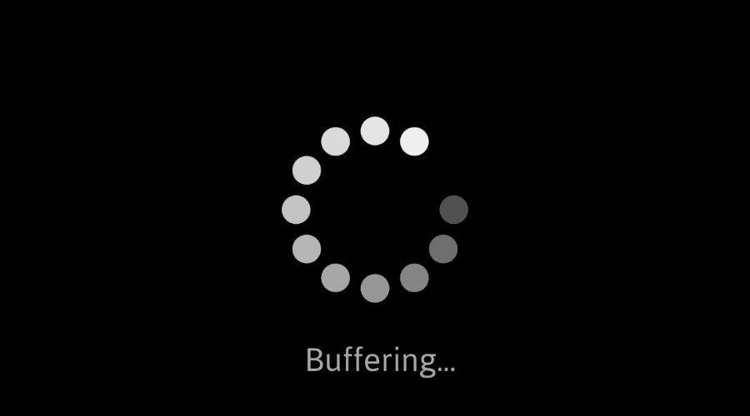
Streaming stored video: challenges
continuous playout constraint: during client video playout, playout timing must match original timing
… but network delays are variable (jitter), so will need client-side buffer to match continuous playout constraint
other challenges:
client interactivity: pause, fast-forward, rewind, jump through video
video packets may be lost, retransmitted

Slide 19
Streaming stored video: playout buffering
constant bit
rate video
transmission
client video
reception
constant bit
rate video
playout at client
Cumulative data
variable
network
delay
buffered
video
client playout
delay
time
client-side buffering and playout delay: compensate for network-added delay, delay jitter

Slide 20
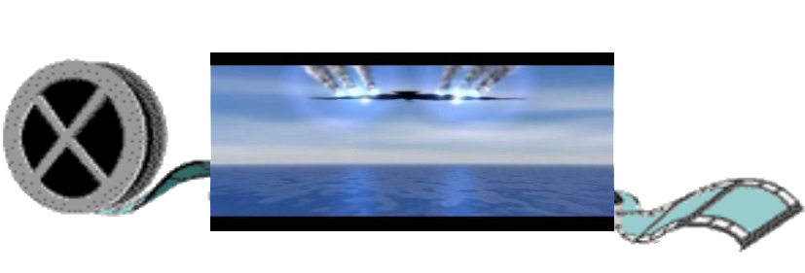
Streaming multimedia: DASH
Dynamic, Adaptive Streaming over HTTP
server:
divides video file into multiple chunks
each chunk encoded at multiple different rates
different rate encodings stored in different files
files replicated in various CDN nodes
manifest file: provides URLs for different chunks
...
...
?
...
client
client:
periodically estimates server-to-client bandwidth
consulting manifest, requests one chunk at a time
chooses maximum coding rate sustainable given current bandwidth
can choose different coding rates at different points in time (depending on available bandwidth at time), and from different servers

Slide 21

Streaming multimedia: DASH
“intelligence” at client: client determines
when to request chunk (so that buffer starvation, or overflow does not occur)
what encoding rate to request (higher quality when more bandwidth available)
...
...
?
...
client
where to request chunk (can request from URL server that is “close” to client or has high available bandwidth)
Streaming video = encoding + DASH + playout buffering

Slide 22
Content distribution networks (CDNs)
challenge: how to stream content (selected from millions of videos) to hundreds of thousands of simultaneous users?
option 1: single, large “mega-server”
single point of failure
point of network congestion
long (and possibly congested) path to distant clients
….quite simply: this solution doesn’t scale

Slide 23


Content distribution networks (CDNs)
challenge: how to stream content (selected from millions of videos) to hundreds of thousands of simultaneous users?
option 2: store/serve multiple copies of videos at multiple geographically distributed sites (CDN)
enter deep: push CDN servers deep into many access networks
close to users
Akamai: 240,000 servers deployed
in > 120 countries (2015)
bring home: smaller number (10’s) of larger clusters in POPs near access nets
used by Limelight

Slide 24



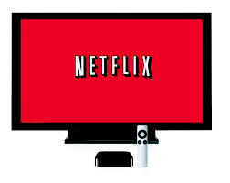
Content distribution networks (CDNs)
CDN: stores copies of content (e.g. MADMEN) at CDN nodes
subscriber requests content, service provider returns manifest
using manifest, client retrieves content at highest supportable rate
may choose different rate or copy if network path congested
…
…
…
manifest file
…
where’s Madmen?
…
…
Notes:
24
Akamai: 100,000+ servers in 1000+ clusters in 1000+ networks in 70+ countries serving trillions of requests a day.
How many people use Netflix?

Slide 25
Content distribution networks (CDNs)
OTT: “over the top”
…
…
Internet host-host communication as a service
…
…
OTT challenges: coping with a congested Internet from the “edge”
what content to place in which CDN node?
from which CDN node to retrieve content? At which rate?
…
…
Notes:
25
peak load: 7million viewers, 2 Tbytes via

Slide 26
Application Layer: Overview
P2P applications
video streaming and content distribution networks
socket programming with UDP and TCP
Principles of network applications
Web and HTTP
E-mail, SMTP, IMAP
The Domain Name System DNS

Slide 27
Socket programming
goal: learn how to build client/server applications that communicate using sockets
socket: door between application process and end-end-transport protocol
application
socket
application
controlled by
app developer
process
process
transport
transport
network
network
controlled
by OS
link
Internet
link
physical
physical

Slide 28
Socket programming
Two socket types for two transport services:
UDP: unreliable datagram
TCP: reliable, byte stream-oriented
Application Example:
client reads a line of characters (data) from its keyboard and sends data to server
server receives the data and converts characters to uppercase
server sends modified data to client
client receives modified data and displays line on its screen

Slide 29
Socket programming with UDP
UDP: no “connection” between client and server:
no handshaking before sending data
sender explicitly attaches IP destination address and port # to each packet
receiver extracts sender IP address and port# from received packet
UDP: transmitted data may be lost or received out-of-order
Application viewpoint:
UDP provides unreliable transfer of groups of bytes (“datagrams”) between client and server processes

Slide 30
Client/server socket interaction: UDP
server (running on serverIP)
client
create socket:
create socket, port= x:
clientSocket =
socket(AF_INET,SOCK_DGRAM)
serverSocket =
socket(AF_INET,SOCK_DGRAM)
Create datagram with serverIP address
And port=x; send datagram via clientSocket
read datagram from
serverSocket
write reply to
serverSocket
specifying client address,
port number
read datagram from
clientSocket
close
clientSocket

Slide 31
Example app: UDP client
Python UDPClient
include Python’s socket library
from socket import *
serverName = ‘hostname’
serverPort = 12000
clientSocket = socket(AF_INET,
SOCK_DGRAM)
message = raw_input(’Input lowercase sentence:’)
clientSocket.sendto(message.encode(),
(serverName, serverPort))
modifiedMessage, serverAddress =
clientSocket.recvfrom(2048)
print modifiedMessage.decode()
clientSocket.close()
create UDP socket for server
get user keyboard input
attach server name, port to message; send into socket
read reply characters from socket into string
print out received string and close socket

Slide 32
Example app: UDP server
Python UDPServer
from socket import *
serverPort = 12000
serverSocket = socket(AF_INET, SOCK_DGRAM)
serverSocket.bind(('', serverPort))
print (“The server is ready to receive”)
while True:
message, clientAddress = serverSocket.recvfrom(2048)
modifiedMessage = message.decode().upper()
serverSocket.sendto(modifiedMessage.encode(),
clientAddress)
create UDP socket
bind socket to local port number 12000
loop forever
Read from UDP socket into message, getting client’s address (client IP and port)
send upper case string back to this client

Slide 33
Socket programming with TCP
Client must contact server
server process must first be running
server must have created socket (door) that welcomes client’s contact
Client contacts server by:
Creating TCP socket, specifying IP address, port number of server process
when client creates socket: client TCP establishes connection to server TCP
when contacted by client, server TCP creates new socket for server process to communicate with that particular client
allows server to talk with multiple clients
source port numbers used to distinguish clients (more in Chap 3)
Application viewpoint
TCP provides reliable, in-order
byte-stream transfer (“pipe”)
between client and server processes

Slide 34
Client/server socket interaction: TCP
server (running on hostid)
client
create socket,
port=x, for incoming request:
serverSocket = socket()
wait for incoming
connection request
TCP
connection setup
create socket,
connect to hostid, port=x
connectionSocket =
serverSocket.accept()
clientSocket = socket()
send request using
clientSocket
read request from
connectionSocket
write reply to
connectionSocket
read reply from
clientSocket
close
connectionSocket
close
clientSocket

Slide 35
Example app: TCP client
Python TCPClient
from socket import *
serverName = ’servername’
serverPort = 12000
clientSocket = socket(AF_INET, SOCK_STREAM)
clientSocket.connect((serverName,serverPort))
sentence = raw_input(‘Input lowercase sentence:’)
clientSocket.send(sentence.encode())
modifiedSentence = clientSocket.recv(1024)
print (‘From Server:’, modifiedSentence.decode())
clientSocket.close()
create TCP socket for server, remote port 12000
No need to attach server name, port

Slide 36
Example app: TCP server
Python TCPServer
from socket import *
serverPort = 12000
serverSocket = socket(AF_INET,SOCK_STREAM)
serverSocket.bind((‘’,serverPort))
serverSocket.listen(1)
print ‘The server is ready to receive’
while True:
connectionSocket, addr = serverSocket.accept()
sentence = connectionSocket.recv(1024).decode()
capitalizedSentence = sentence.upper()
connectionSocket.send(capitalizedSentence.
encode())
connectionSocket.close()
create TCP welcoming socket
server begins listening for incoming TCP requests
loop forever
server waits on accept() for incoming requests, new socket created on return
read bytes from socket (but not address as in UDP)
close connection to this client (but not welcoming socket)

Slide 37
Chapter 2: Summary
our study of network application layer is now complete!
application architectures
client-server
P2P
application service requirements:
reliability, bandwidth, delay
Internet transport service model
connection-oriented, reliable: TCP
unreliable, datagrams: UDP
specific protocols:
HTTP
SMTP, IMAP
DNS
P2P: BitTorrent
video streaming, CDNs
socket programming:
TCP, UDP sockets

Slide 38
Chapter 2: Summary
Most importantly: learned about protocols!
typical request/reply message exchange:
client requests info or service
server responds with data, status code
message formats:
headers: fields giving info about data
data: info(payload) being communicated
important themes:
centralized vs. decentralized
stateless vs. stateful
scalability
reliable vs. unreliable message transfer
“complexity at network edge”

Slide 39
Questions

